Slide 1

#LifeKoKaroLift
Post-Graduate Diploma in ML/AI

Slide 2



Course : Machine Learning
Lecture On : Pre exam session
Instructor : Manish Kumar

Slide 3
Modules Included
Inferential Statistics
Hypothesis Testing
Linear Regression
Advanced Linear Regression
Logistic Regression
DT & Random Forest
Support Vector Machines (SVM)
PCA
Clustering

Slide 4
INFERENTIAL STATISTICS
Expected Value
The expected value for a variable X is the value of X we would “expect” to get after performing the experiment once. It is also called the expectation, average, and mean value
Discrete Probability Distributions
Continuous Probability Distributions
A discrete distribution describes the probability of occurrence of each value of a discrete random variable. A discrete random variable is a random variable that has countable values, such as a list of non-negative integers. Ex. A coin flip
A continuous distribution describes the probabilities of the possible values of a continuous random variable. A continuous random variable is a random variable with a set of possible values (known as the range) that is infinite and uncountable Ex. Commute time of an upgrad employee

Slide 5
EDA
kinds of data source
Public data: Data collected by the government or other public agencies that are made public for the purposes of research are known as Public data.
Private data: Data generated by Banking, telecom, retail, and media are some of the key private sectors that rely heavily on data to make decisions.
kinds of data Analysis
Univariate Analysis
Bivariate Analysis

Slide 6
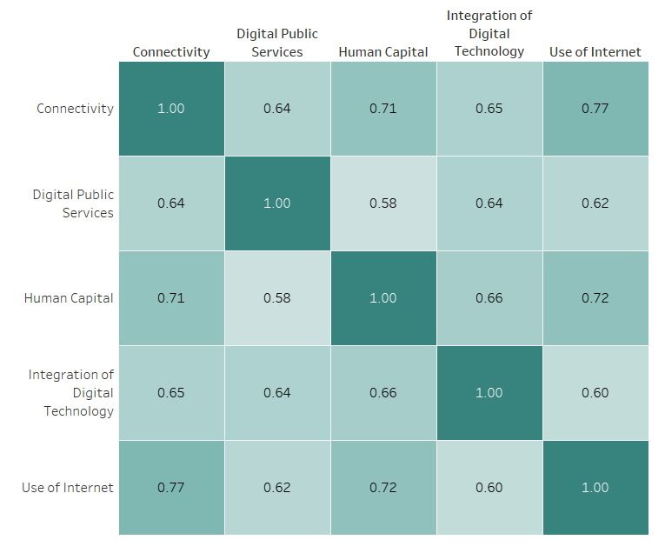
EDA
Poll 1
Please select a category which would lead to highest improvement in “Integration of Digital Technology” category?
Use of internet
Human Capital
Connectivity
Digital public services

Slide 7
EDA
Poll 1 (Answer)
Please select a category which would lead to highest improvement in “Integration of Digital Technology” category?
Use of internet
Human Capital
Connectivity
Digital public services

Slide 8
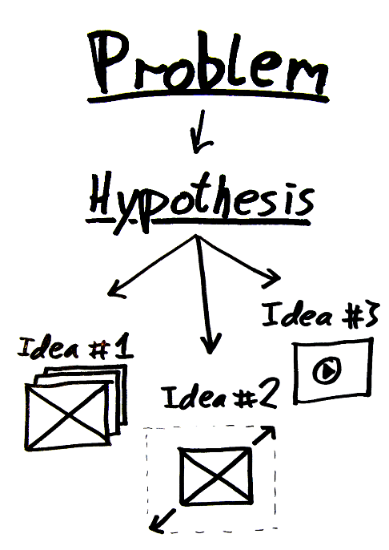
Hypothesis Testing
Hypothesis : a claim or an assumption that we make about one or more population parameters
Types of hypothesis:
Null hypothesis (H₀)
Makes an assumption about the status quo
Always contains the symbols ‘=’, ‘≤’ or ‘≥’
Alternate hypothesis (H₁)
Challenges and complements the null hypothesis
Always contains the symbols ‘≠’, ‘<’ or ‘>’

Slide 9
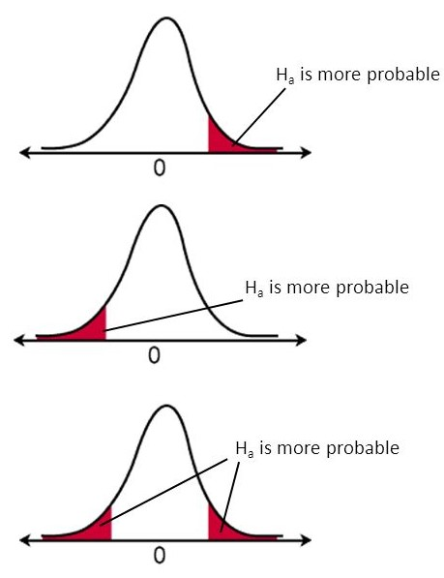
Hypothesis Testing
Types of tests:
Upper-tailed test
The critical region lies on the right side of the distribution
The alternate hypothesis contains the > sign
Lower-tailed test
The critical region lies on the left side of the distribution
The alternate hypothesis contains the < sign
Two-tailed test
The critical region lies on both sides of the distribution
The alternate hypothesis contains the ≠ sign

Slide 10
Hypothesis Testing
Making a decision
- Critical value method:
Calculate the value of Zc from the given value of α (significance level)
Calculate the critical values (UCV and LCV) from the value of Zc
Make the decision on the basis of the value of the sample mean ¯x with respect to the critical values (UCV AND LCV)
P-value method:
Calculate the value of z-score for the sample mean point on the distribution
Calculate the p-value from the cumulative probability for the given z-score using the z-table
Make a decision on the basis of the p-value (multiply it by 2 for a two-tailed test) with respect to the given value of α (significance value).

Slide 11
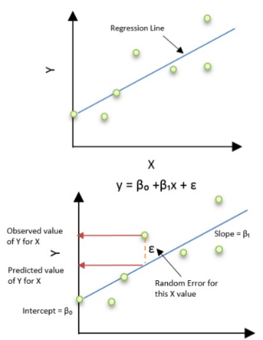
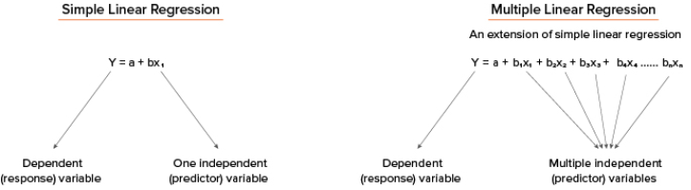
Linear Regression
What Is Linear Regression?
It is the simplest form of regression. It is a technique in which the dependent variable is continuous in nature. The relationship between the dependent variable and independent variables is assumed to be linear in nature.
Simple linear regression, gets its adjective ‘simple’, because it concerns the study of only one predictor variable, similarly multiple linear regression concerns the study of two or more predictor variables.

Slide 12
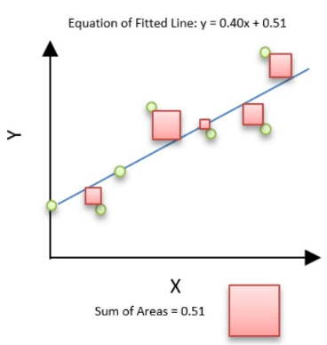
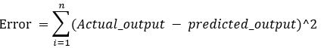
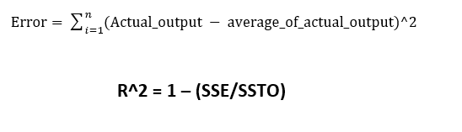
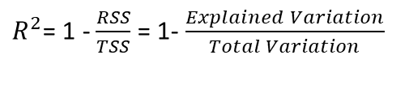
Linear Regression
Residual sum of squares (RSS)
This gives information about how much the target value varies around the regression line (predicted value).
The best-fit line is obtained by minimizing a quantity called Residual Sum of Squares (RSS) which could be optimized using Gradient Descent to get parameters of the best fit line.
Total sum of squares (TSS)
This tells how much the data point move around the mean.
R-squared is a statistical measure of how close the data are to the fitted regression line. It is also known as the coefficient of determination
$R^{2}$= 1 - $\frac{RSS}{TSS}$ = 1- $\frac{Explained Variation}{Total Variation}$

Slide 13



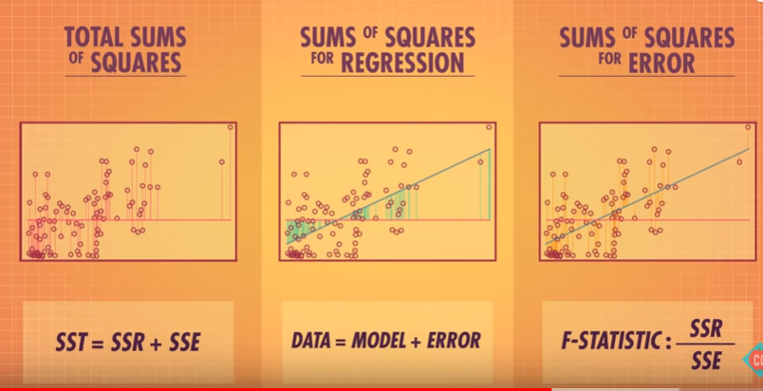

Poll 2
Which of the figures best represent RSS & TSS respectively?
(1)
(2)
(3)
Practice in teams of 4 students
Industry expert mentoring to learn better
Get personalised feedback for improvements
1 & 2
2 & 3
1 & 3
3 & 1
23-11-2019
11

Slide 14
Poll 2(Answer)
Which of the figures best represent RSS & TSS respectively?
(1)
(2)
(3)
Practice in teams of 4 students
Industry expert mentoring to learn better
Get personalised feedback for improvements
1 & 2
2 & 3
1 & 3
3 & 1
23-11-2019
12

Slide 15
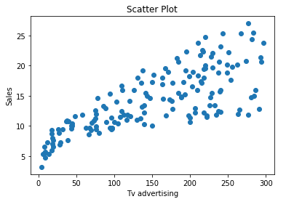
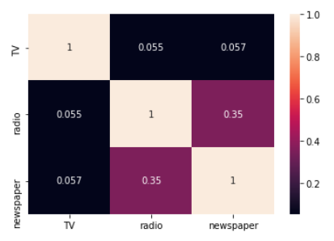
Assumptions of Linear Regression
Linear Relationship between the features and target
According to this assumption there is linear relationship between the features and target. Linear regression captures only linear relationship. This can be validated by plotting a scatter plot between the features and the target.
Little or no Multicollinearity between the features
Multicollinearity is a state of very high inter-correlations or inter-associations among the independent variables. It is therefore a type of disturbance in the data if present weakens the statistical power of the regression model. Pair plots and heat maps(correlation matrix) can be used for identifying highly correlated features.

Slide 16
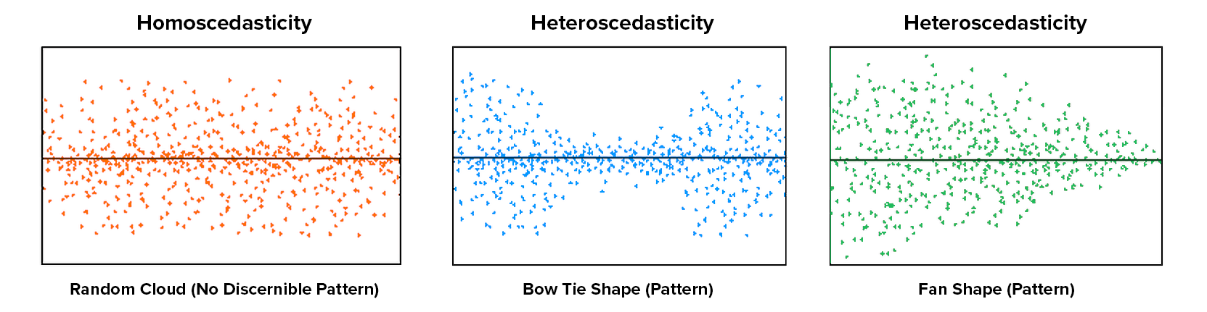
Assumptions of Linear Regression
Homoscedasticity Assumption
Homoscedasticity describes a situation in which the error term (that is, the “noise” or random disturbance in the relationship between the features and the target) is the same across all values of the independent variables
Notes:
The leftmost graph shows no definite pattern i.e constant variance among the residuals,the middle graph shows a specific pattern where the error increases and then decreases with the predicted values violating the constant variance rule and the rightmost graph also exhibits a specific pattern where the error decreases with the predicted values depicting heteroscedasticity

Slide 17
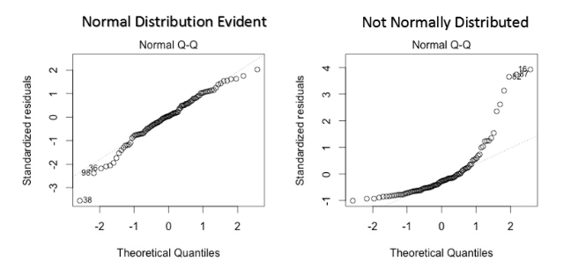
Assumptions of Linear Regression
Error terms are normally distributed with mean zero
The fourth assumption is that the error(residuals) follow a normal distribution. One particular repercussion of the error terms not being normally distributed is that the p-values obtained during the hypothesis test to determine the significance of the coefficients become unreliable.
Normal distribution of the residuals can be validated by plotting a q-q plot.
Notes:
However, a less widely known fact is that, as sample sizes increase, the normality assumption for the residuals is not needed. More precisely, if we consider repeated sampling from our population, for large sample sizes, the distribution (across repeated samples) of the ordinary least squares estimates of the regression coefficients follow a normal distribution. As a consequence, for moderate to large sample sizes, non-normality of residuals should not adversely affect the usual inferential procedures. This result is a consequence of an extremely important result in statistics, known as the central limit theorem.

Slide 18
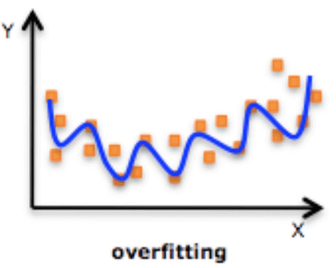
Regularized Linear Regression
One of the major aspects of training your machine learning model is avoiding overfitting. The model will have a low accuracy if it is overfitting. This happens because your model is trying too hard to capture the noise in your training dataset.
Regularization
This is a form of regression, that constrains/ regularizes or shrinks the coefficient estimates towards zero. In other words, this technique discourages learning a more complex or flexible model, so as to avoid the risk of overfitting.

Slide 19
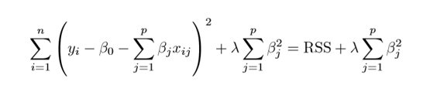
Ridge Regression
RSS is modified by adding the shrinkage quantity. Now, the coefficients are estimated by minimizing this function. Here, λ is the tuning parameter that decides how much we want to penalize the flexibility of our model. The increase in flexibility of a model is represented by increase in its coefficients, and if we want to minimize the above function, then these coefficients need to be small.

Slide 20
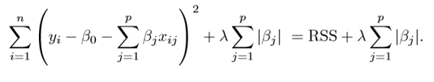
Lasso Regression
Lasso is another variation, in which the above function is minimized. Its clear that this variation differs from ridge regression only in penalizing the high coefficients.

Slide 21
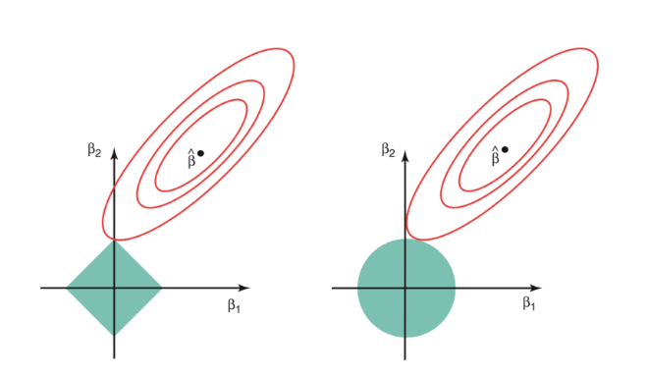
Regularized Linear Regression
The ridge regression is expressed by β1² + β2² ≤ s. This implies that ridge regression coefficients have the smallest RSS(loss function) for all points that lie within the circle given by β1² + β2² ≤ s
The lasso, the equation becomes,|β1|+|β2|≤ s. This implies that lasso coefficients have the smallest RSS(loss function) for all points that lie within the diamond given by |β1|+|β2|≤ s.

Slide 22
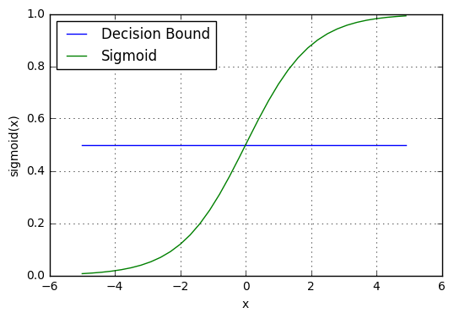
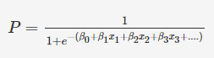
LOGISTIC REGRESSION
What is logistic regression?
Logistic regression is a classification algorithm used to assign observations to a discrete set of classes. Unlike linear regression which outputs continuous number values, logistic regression transforms its output using the logistic sigmoid function to return a probability value which can then be mapped to two or more discrete classes.
23-11-2019
13

Slide 23
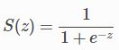
Logistic regression
Sigmoid activation
In order to map predicted values to probabilities, we use the sigmoid function. The function maps any real value into another value between 0 and 1. In machine learning, we use sigmoid to map predictions to probabilities.
Decision boundary
Our current prediction function returns a probability score between 0 and 1. In order to map this to a discrete class (true/false, cat/dog), we select a threshold value or tipping point above which we will classify values into class 1 and below which we classify values into class 2.
p≥0.5,class=1
p<0.5,class=0

Slide 24
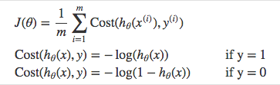
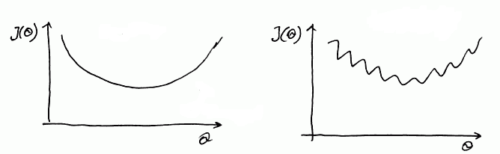
Logistic regression
Cost function
But we shouldn’t use the same cost function MSE as we did for linear regression.
Why? You can refer to chapter 3 of Michael Neilson’s deep learning book for the complete explanation.
For now
it’s because our prediction function is non-linear Squaring this prediction as we do in MSE results in a non-convex function with many local minimums.
If our cost function has many local minimums, gradient descent may not find the optimal global minimum.
Convex
Non - Convex

Slide 25
LOGISTIC REGRESSION
Sigmoid curve is used to model in logistic regression and in order to find the best-fit sigmoid curve, we need to vary β0 and β1,… βn until we get the combination of beta values that maximizes the likelihood
You saw that the following linearized equation is much easier to interpret:
ln(P/(P1−P)) = β0+β1x
In the diabetes patient example:
The left-hand side of this equation is what is called log odds. Basically, the odds of having diabetes (P/1-P), indicate how much likelier a person is to have diabetes than to not have it
data preparation was done, which involved the following steps:
Missing value imputation
Outlier treatment
Standardizing scales of continuous variables
Dummy variable creation for categorical variables

Slide 26
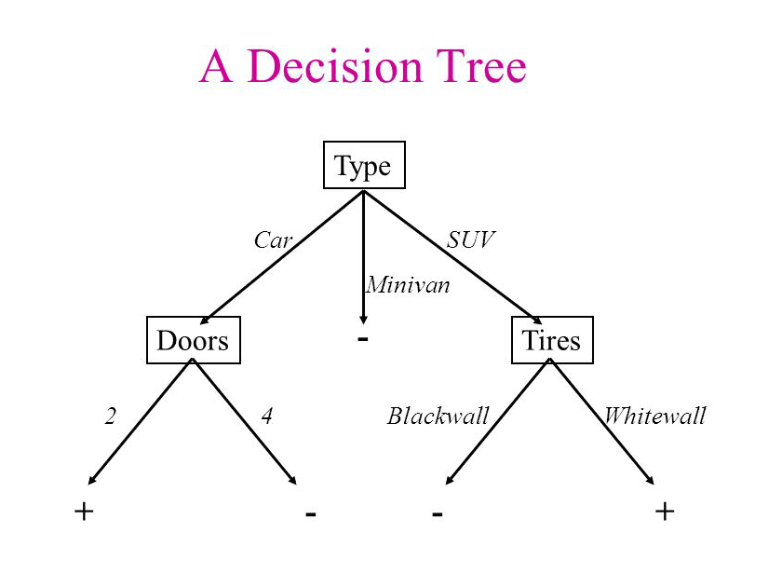
Decision Tree
Decision tree is the most powerful and popular tool for classification and prediction. A Decision tree is a flowchart like tree structure, where each internal node denotes a test on an attribute, each branch represents an outcome of the test, and each leaf node (terminal node) holds a class label.

Slide 27
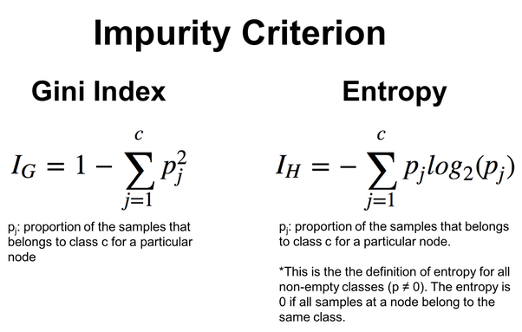
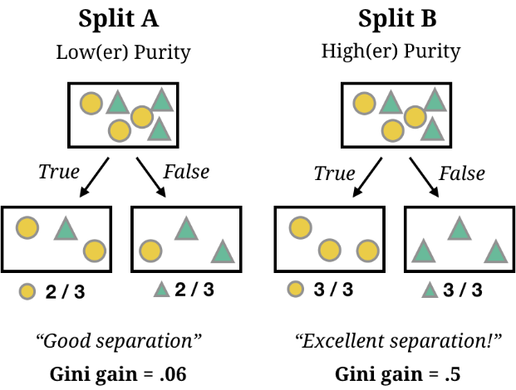
where to split ?

Slide 28
When to stop splitting?
As a problem usually has a large set of features, it results in large number of split, which in turn gives a huge tree. Such trees are complex and can lead to overfitting.
Pruning
Remove the branches that make use of features having low importance. This way, we reduce the complexity of tree, and thus increasing its predictive power by reducing overfitting.
Truncation
Stop the tree wile it is still growing so that it may not end up with leaves containing vary less data-points, one way to do this is by setting the minimum number

Slide 29
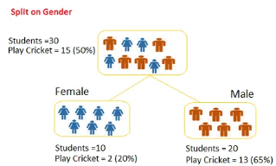
Poll 4
Question: we want to segregate the students based on target variable (playing cricket or not).we split the population using input variables Gender find the homogeneity of sub-nodes using Gini.
0.51
0.59
0.33
0.49
Practice in teams of 4 students
Industry expert mentoring to learn better
Get personalised feedback for improvements
23-11-2019
11

Slide 30
Poll 4 (Solution)
Question: we want to segregate the students based on target variable (playing cricket or not).we split the population using input variables Gender find the homogeneity of sub-nodes using Gini.
0.51
0.59
0.33
0.49
Practice in teams of 4 students
Industry expert mentoring to learn better
Get personalised feedback for improvements
Calculate, Gini for sub-node Female = (0.2)*(0.2)+(0.8)*(0.8)=0.68
Gini for sub-node Male = (0.65)*(0.65)+(0.35)*(0.35)=0.55
Calculate weighted Gini for Split Gender = (10/30)*0.68+(20/30)*0.55 = 0.59
23-11-2019
11

Slide 31
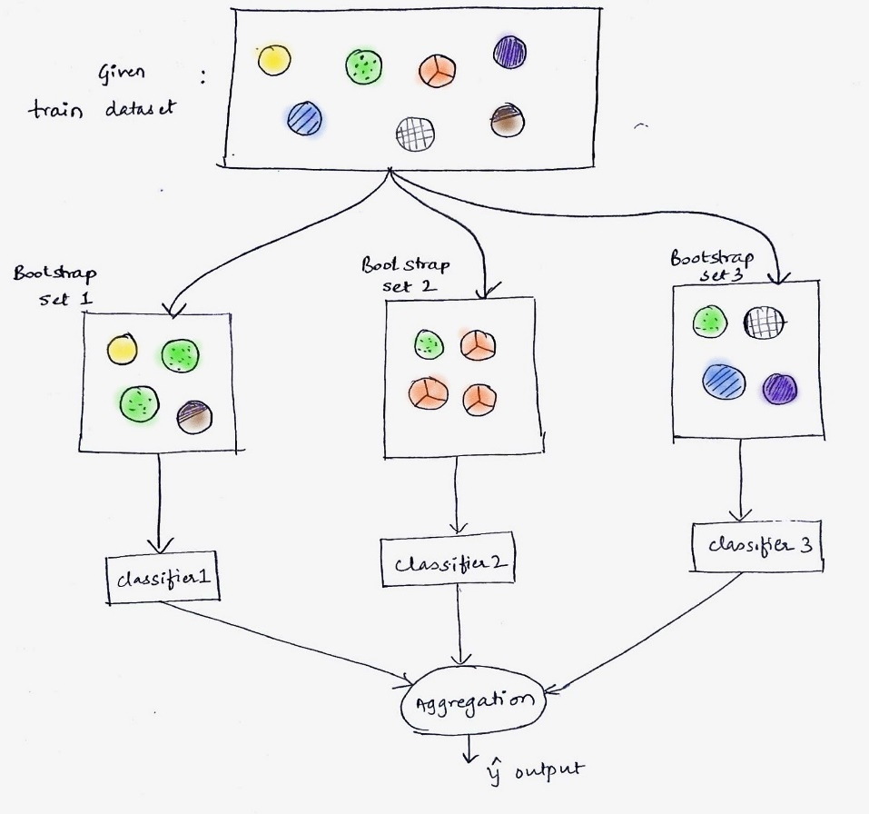
Different ensemble methods
Bagging, that often considers homogeneous weak learners, learns them independently from each other in parallel and combines them following some kind of deterministic averaging process

Slide 32
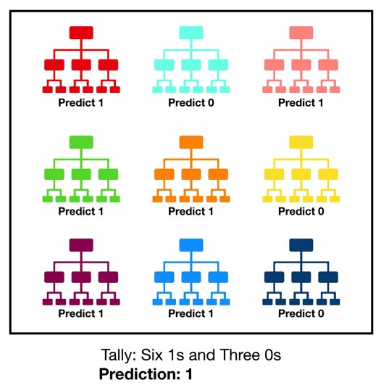
Random Forest
Random forest, like its name implies, consists of a large number of individual decision trees that operate as an ensemble. Each individual tree in the random forest spits out a class prediction and the class with the most votes becomes our model’s prediction
The reason for this wonderful effect is that the trees protect each other from their individual errors (as long as they don’t constantly all err in the same direction)

Slide 33
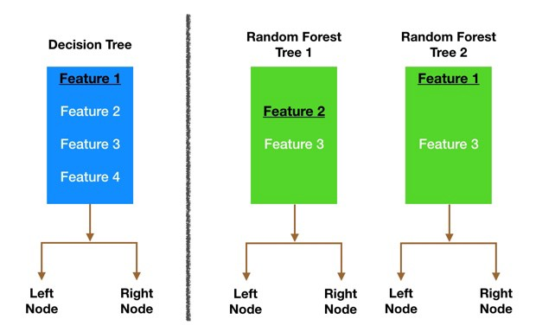
Random Forest
Bagging (Bootstrap Aggregation) — Decision trees are very sensitive to the data they are trained on — small changes to the training set can result in significantly different tree structures. Random forest takes advantage of this by allowing each individual tree to randomly sample from the dataset with replacement, resulting in different trees.
Feature Randomness — In a normal decision tree, while splitting a node, we consider all the features and pick the one that produces the most separation. In contrast, each tree in a random forest can pick only from a random subset of features. This forces even more variation amongst the trees in the model and ultimately results in lower correlation across trees and more diversification.

Slide 34
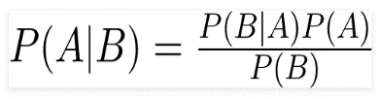
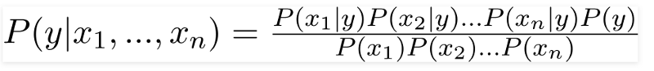
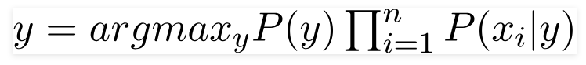
Naive Bayes
What is Naive Bayes?
A Naive Bayes classifier is a probabilistic machine learning model that is based on the Bayes theorem
Bayes Theorem
Using Bayes theorem, we can find the probability of A happening, given that B has occurred. Here, B is the evidence and A is the hypothesis. The assumption made here is that the predictors/features are independent. That is presence of one particular feature does not affect the other. Hence it is called naive.
There could be cases where the classification could be multiclass. Therefore, we need to find the class y with maximum probability.
Naive Bayes algorithms are mostly used in sentiment analysis, spam filtering, recommendation systems etc. They are fast and easy to implement but their biggest disadvantage is that the requirement of predictors to be independent. In most of the real life cases, the predictors are dependent, this hinders the performance of the classifier.

Slide 35

Why is “Naive” Bayes naive?

Slide 36

Despite its practical applications, especially in text mining, Naive Bayes is considered “Naive” because it makes an assumption that is virtually impossible to see in real-life data: the conditional probability is calculated as the pure product of the individual probabilities of components. This implies the absolute independence of features — a condition probably never met in real life.
Example : a Naive Bayes classifier that figured out that you liked pickles and ice cream would probably naively recommend you a pickle ice cream.

Slide 37
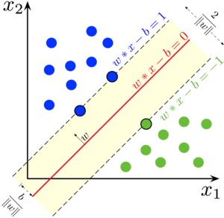
SUPPORT VECTOR MACHINES
Maximal Margin Classifier
Creates the best separating line that maintains the largest possible equal distance from the nearest points of both the classes
Maximal Margin Classifier has certain limitations. For instance, it will not find a separator if the classes are not linearly separable
Soft Margin Classifier
The Soft Margin Classifier overcomes the drawbacks of the Maximal Margin Classifier by allowing certa1in points to be misclassified. You control the amount of misclassifications using the cost of misclassification 'C', where C is the maximum value of the summation of the slack variable epsilon(ϵ)
i.e. ∑ϵi ≤ C

Slide 38
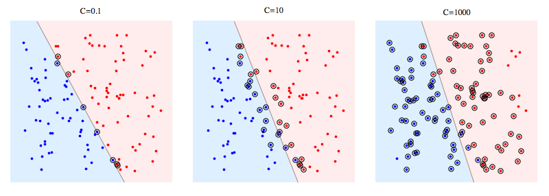
SUPPORT VECTOR MACHINES
∑ϵi ≤ C
If C is high, a higher number of points are allowed to be misclassified or violate the margin. In this case, the model is flexible, more generalizable, and less likely to overfit. In other words, it has a high bias.
On the other hand, if C is low, a lesser number of points are allowed to be misclassified or violate the margin. In this case, the model is less flexible, less generalizable, and more likely to overfit. In other words, it has a high variance.

Slide 39

SUPPORT VECTOR MACHINES
not all data are linearly separable. In fact, in the real world, almost all the data are randomly distributed, which makes it hard to separate different classes linearly.
https://medium.com/@zxr.nju/what-is-the-kernel-trick-why-is-it-important-98a98db0961d

Slide 40
Poll 3
The effectiveness of an SVM depends upon?
Selection of Kernel
Kernel Parameters
Soft Margin Parameter C
All of the above
Practice in teams of 4 students
Industry expert mentoring to learn better
Get personalised feedback for improvements
23-11-2019
11

Slide 41
Poll 3(Answer)
The effectiveness of an SVM depends upon?
Selection of Kernel
Kernel Parameters
Soft Margin Parameter C
All of the above
Practice in teams of 4 students
Industry expert mentoring to learn better
Get personalised feedback for improvements
23-11-2019
11

Slide 42
Poll 4
Support vectors are the data points that lie closest to the decision surface?
TRUE
FALSE
Practice in teams of 4 students
Industry expert mentoring to learn better
Get personalised feedback for improvements
23-11-2019
11

Slide 43
Poll 4 (Answer)
Support vectors are the data points that lie closest to the decision surface?
TRUE
FALSE
Practice in teams of 4 students
Industry expert mentoring to learn better
Get personalised feedback for improvements
23-11-2019
11

Slide 44
Model Evaluation
A confusion matrix shows the number of correct and incorrect predictions made by the classification model compared to the actual outcomes (target value) in the data. The matrix is NxN, where N is the number of target values (classes). Performance of such models is commonly evaluated using the data in the matrix. The following table displays a 2x2 confusion matrix for two classes (Positive and Negative).
Confusion Matrix | Target
 | Positive | Negative
Positive | a | b | Positive Predictive Value | a/(a+b)
Negative | c | d | Negative Predictive Value | d/(c+d)
 | Sensitivity | Specificity | Accuracy = (a+d)/(a+b+c+d)
Accuracy : the proportion of the total number of predictions that were correct.
Positive Predictive Value or Precision : the proportion of positive cases that were correctly identified.
Negative Predictive Value : the proportion of negative cases that were correctly identified.
Sensitivity or Recall : the proportion of actual positive cases which are correctly identified.
Specificity : the proportion of actual negative cases which are correctly identified.

Slide 45
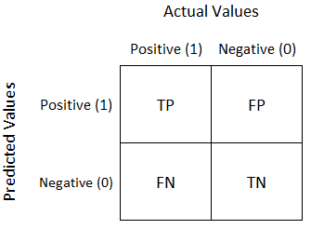
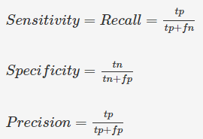
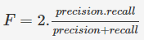
LOGISTIC REGRESSION
A confusion matrix shows the number of correct and incorrect predictions made by the classification model compared to the actual outcomes (target value) in the data.

Slide 46
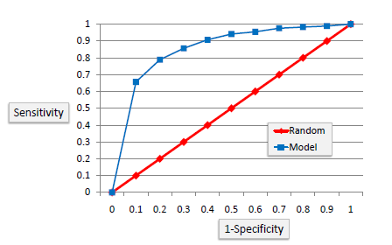
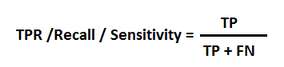
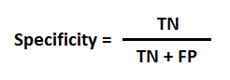
Model Evaluation
ROC Curves summarize the trade-off between the true positive rate and false positive rate for a predictive model using different probability thresholds
It’s often used as a proxy for the trade-off between the sensitivity of the model (true positives) vs the fall-out or the probability it will trigger a false alarm (false positives).

Slide 47
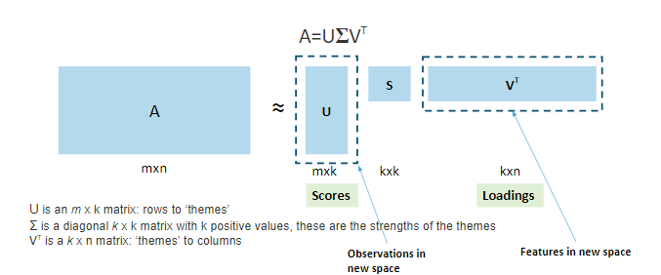
PCA
PCA is useful when you have a large number of potentially correlated variables. Also, PCA can be used to visualize complex datasets.
We saw that if each row in the original dataset A (m x n) represents a user and each column an item such as a book, then:
The matrix U (m x k) maps the users to the new k themes/latent variables
The diagonal matrix S (k x k) represents the strength of each feature
Matrix V' (k x n) maps each of the k themes/latent variables to the original n features.

Slide 48
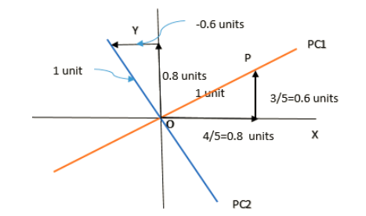
Poll 5
What are the PC1 and PC2 values for given x=3 and y=2 ?
3.4 & 1.2
3.6 & -0.2
3.4 & -0.2
3.6 & 1.2
Practice in teams of 4 students
Industry expert mentoring to learn better
Get personalised feedback for improvements
23-11-2019
11

Slide 49
Poll 5 (Answer)
What are the PC1 and PC2 values for given x=3 and y=2 ?
3.4 & 1.2
3.6 & -0.2
3.4 & -0.2
3.6 & 1.2
Practice in teams of 4 students
Industry expert mentoring to learn better
Get personalised feedback for improvements
23-11-2019
11

Slide 50
CLUSTERING
K-Mean Clustering
The number of clusters that you want to divide your data points into, i.e. the value of K has to be pre-determined.
The choice of the initial cluster centers can have an impact on the final cluster formation.
The clustering process is very sensitive to the presence of outliers in the data.
Since the distance metric used in the clustering process is the Euclidean distance, you need to bring all your attributes on the same scale. This can be achieved through standardization.
The K-Means algorithm does not work with categorical data.
Choosing the number of clusters K
Elbow method
Compute clustering algorithm (e.g., k-means clustering) for different values of k. For instance, by varying k from 1 to 10 clusters.
For each k, calculate the total within-cluster sum of square (wss)
Plot the curve of wss according to the number of clusters k.
The location of a bend (knee) in the plot is generally considered as an indicator of the appropriate number of clusters.

Slide 51
CLUSTERING
Hierarchical Clustering algorithm
Given a set of N items to be clustered, the steps in the hierarchical clustering are:
Calculate the NxN distance (similarity) matrix, which calculates the distance of each data point from the other.
Start by assigning each item to its own cluster, so that if you have N items, you now have N clusters, each containing just one item.
Find the closest (most similar) pair of clusters and merge them into a single cluster, so that now you have one less cluster.
Compute distances (similarities) between the new cluster and each of the old clusters.
Repeat steps 3 and 4 until all items are clustered into a single cluster of size N
Single Linkage
Here, the distance between 2 clusters is defined as the shortest distance between points in the two clusters
Complete Linkage
Here, the distance between 2 clusters is defined as the maximum distance between any 2 points in the clusters
Average Linkage
Here, the distance between 2 clusters is defined as the average distance between every point of one cluster to every other point of the other cluster.

Slide 52
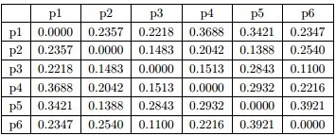
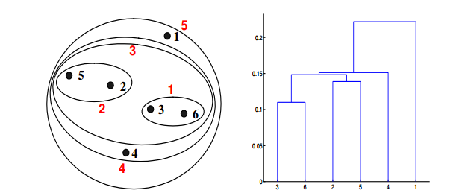
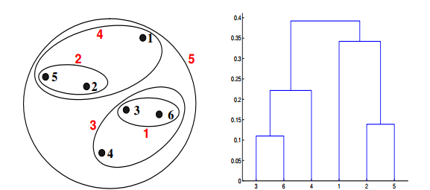
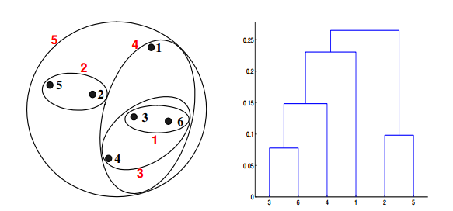
Poll 6
Which of the following clustering representations and dendrogram depicts the use of MIN or Single link proximity function in hierarchical clustering?
Distance Matrix
Practice in teams of 4 students
Industry expert mentoring to learn better
Get personalised feedback for improvements
(A)
(B)
(C)
23-11-2019
11

Slide 53
Poll 6 (Answer)
Which of the following clustering representations and dendrogram depicts the use of Single link proximity function in hierarchical clustering?
Distance Matrix
Practice in teams of 4 students
Industry expert mentoring to learn better
Get personalised feedback for improvements
(A)
(B)
(C)
23-11-2019
11

Slide 54
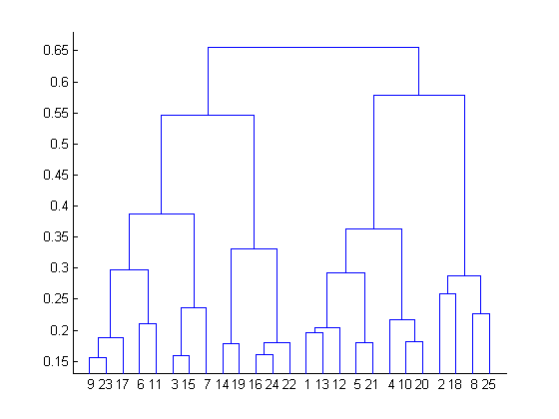
Poll 7
What is the most appropriate no. of clusters for the data points represented by the following dendrogram?
A. 2
B. 4
C. 6
D. 8
Practice in teams of 4 students
Industry expert mentoring to learn better
Get personalised feedback for improvements
23-11-2019
11

Slide 55
Poll 7 (Answer)
What is the most appropriate no. of clusters for the data points represented by the following dendrogram?
A. 2
B. 4
C. 6
D. 8
Practice in teams of 4 students
Industry expert mentoring to learn better
Get personalised feedback for improvements
23-11-2019
11

Slide 56
#LifeKoKaroLift
Thank You!

